Slide 1
OBI – a high level overview
Bjoern Peters
3/22/2010
Vancouver Workshop

Slide 2
OBI – a user driven project
19 communities that recognized they were trying to solve the same / related problems
5 year effort
2 phone calls per week, 2 meetings per year
first stable release (Philly / 1.0) in Oct. 2009
Paper submitted to Nat. Biotechnology (positive reviews but major revisions…)

Slide 3
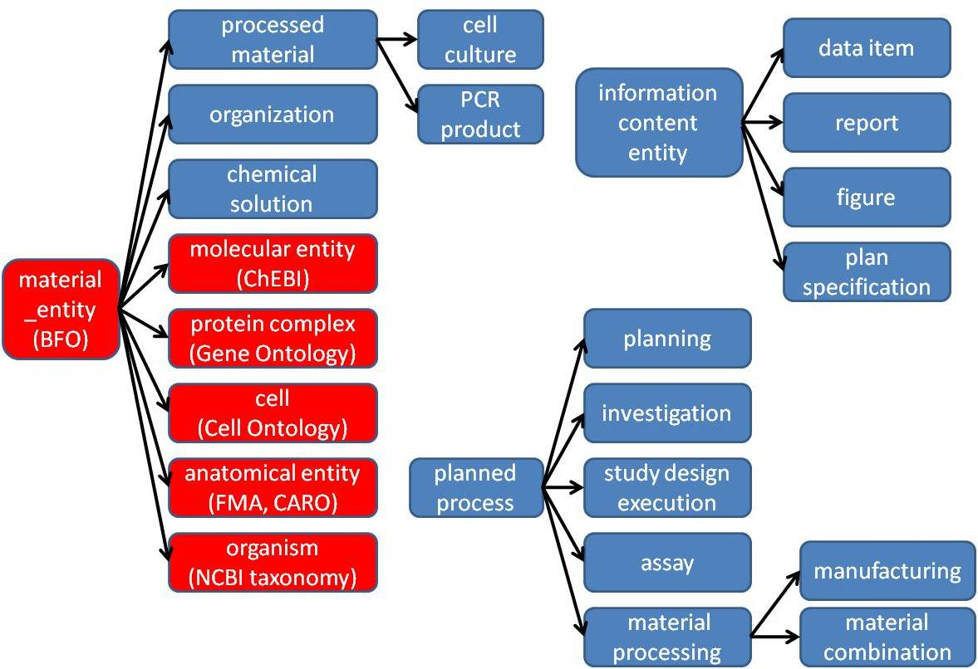
High level class hierarchy

Slide 4
material entity
merged bfo:object, object part, object aggregate (what is a cell inside my body?)
import ‘natural biomaterials’ (MIREOT mechanism), e.g. organism (NCBI taxonomy), anatomical entity (FMA), molecular entity (ChEBI)
OBI’s primary scope
‘processed material entities’
output of a planned material transformation process
would not exist without intelligent life around
some ‘natural biomaterials’ can also be created (e.g. molecules) → no asserted disjoint
specimen, study subject
material entities about which information is gathered during an investigation
may or may not be processed materials

Slide 5
planned process
realize a ‘plan specification’ which includes an ‘objective specification’ (describing the desired endpoint)
have specified inputs and outputs (=participants called out in the specification)
high level classes:
material processing
assay
data transformation

Slide 6
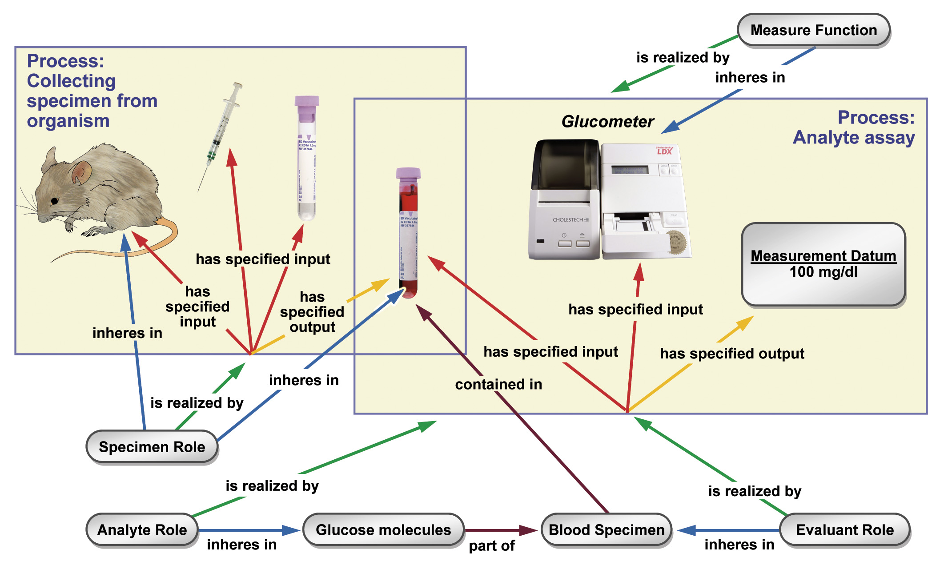

Slide 7
information content entities
IAO, separate effort spawned of from OBI, but tightly interlinked
every information content entity is_about something
Examples: plan specification, journal article, data item
OBI subclasses these, e.g.: study design, dependent variable specification, measurement datum

Slide 8
More classes
roles – specimen role, author role
functions – contain function, measurement function
organizations – manufacturer, regulatory agency

Slide 9
Key elements of OBI design procedure
Metadata
MIREOT
Deprecation
Design patterns (in development)

Slide 10
Metadata
Theory and Practice

Slide 12
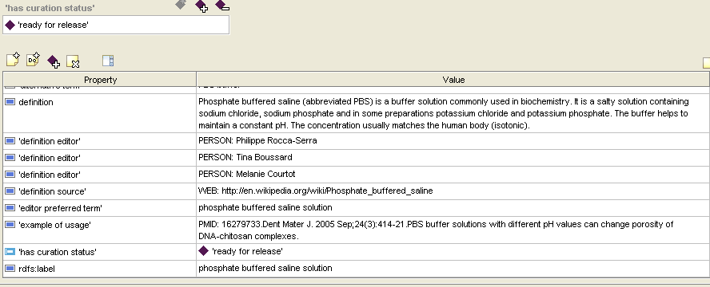
Need to open obi-edit.pprj
In Protégé 3.4.4
Tags for future magic
rdfs:label is used for editing, ‘editor preferred term’ is overwritten

Slide 13
MIREOT
minimal set to unambiguously identify a term
URI of the class
URI of the source ontology
Position in the target ontology
optional set of information
Label,
Definition,
Other annotations: adding “human-readable” information
Superclasses: for example, NCBI taxonomy

Slide 14
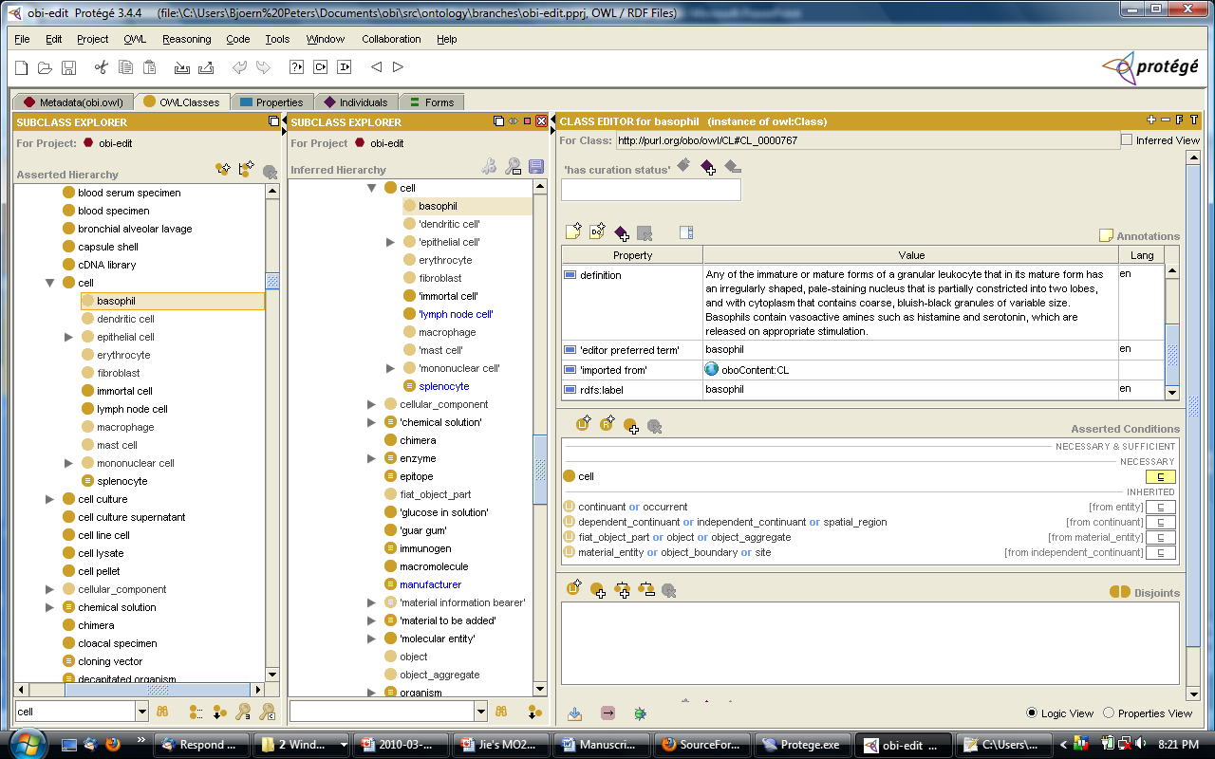

Slide 15
Deprecation
Terms occasionally need to be retired (called obsoletion or deprecation). No term just gets deleted.
Prior to deprecation - notice: to mailing lists, soliciting opinions.
Okay to edit the file and obsolete it immediately, as long as the person who does the editing is willing to revert if objections are raised.
Once the decision to deprecate has been made:
An editor note will be added explaining or pointing to a discussion of the reason why the term is being deprecated
a suggestion of more appropriate terms to use may be added
Determine "obsolescence reason specification“: term imported, term split, placeholder removed, terms merged, failed exploratory term, other.
Deleted classes are moved under the ObsoleteClass
Identifiers are not re-used so classes can be tracked.
Label is prefixed with ‘obsolete_’

Slide 16
Design patterns
We need to scale up to deal with large scale term submissions
Discuss design patterns in detail, then apply to collection of terms (with no further discussion)
Potentially keep large collections in separate files
→ This is work in progress

Slide 17
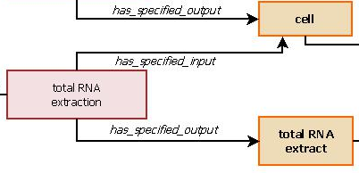
Material Types
Design Pattern
A processed material which is the specified output of a planned process
E-TABM-34
‘total RNA extract’ is a processed material which is the specified output of
a ‘total RNA extraction’ process.
Notes:
All terms fit expect ‘whole_organism’ (used in 0.22% of experiments)
‘molecular mixture’ mainly chromatin (protein+DNA) used in Chip-chip experiments (binding_site_identification_design)
Over 95% ‘synthetic_DNA’ and ‘synthetic_RNA’ were used as the output of a labeling process
Less than 5% ‘synthetic_DNA’ used as the output of an amplification process, can use OBI ‘amplified DNA’

Slide 18
Material Types
A processed material which is the specified output of a planned process
Notes:
whole_organism did not fit the pattern
Synthetic_RNA or _DNA were renamed as labeled RNA/DNA specimen because over 95% were
used as an output of labeling process
Generally, molecular_mixture referred to chromation (protein+DNA)
need a more specific name to add into OBI
Notes:
All terms fit expect ‘whole_organism’ (used in 0.22% of experiments)
‘molecular mixture’ mainly chromatin (protein+DNA) used in Chip-chip experiments (binding_site_identification_design)
Over 95% ‘synthetic_DNA’ and ‘synthetic_RNA’ were used as the output of a labeling process
Less than 5% ‘synthetic_DNA’ used as the output of an amplification process, can use OBI ‘amplified DNA’

Slide 19
Conclusions
core structure is in place, solidified over several years, and now usable
design process has been formalized, novel elements have been developed
… but there is more than enough to do.

